Slide 1
Observer design pattern

Slide 2
Introduction
Observer design pattern is behavioral pattern
Used to assure consistency between objects.
Separation of the objects that is dependent on each other.
It used to make relation between objects at run time not compile time.
Used in MVC(mainly Model & GUI part)

Slide 3
Intent
Define a one-to-many dependency between objects so that when one object changes state, all its dependents are notified and updated automatically.
Object that changes called “Subject/Observable”
Object that receives updates called “Observer”

Slide 4
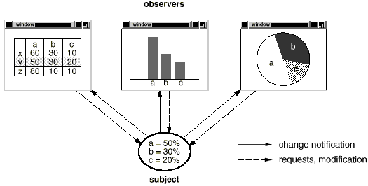
Example:

Slide 5
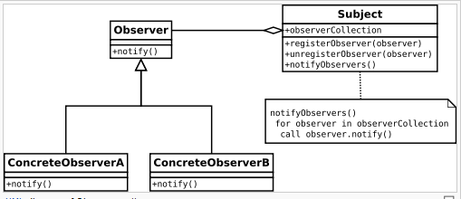
Class diagram

Slide 6
Sequence diagram
Sequence diagram
observer
Subject
Register/attach
Change state trigger notification
notify()/update
getstate()

Slide 7
Example

Slide 8
Example
Refactored

Slide 9
Advantages
Minimal coupling between the Subject and the Observer:
  Can reuse subjects without reusing their observers and vice versa.
  Observers can be added without modifying the subject.
  All subject knows is its list of observers so make decoupling.
  Subject does not need to know the concrete class of an observer.

Slide 10
Disadvantages
The Observer interface has to be implemented by ConcreteObserver, which involves inheritance. There is no option for composition, as the Observer interface cannot be instantiated.
The order of Observer notification is undependable
The subject has to bear the cost of communication with all the Observers

Slide 11
Implementations Issues
How does the subject keep track of its observers?
Array, linked list, Vector
What if an observer wants to observe more than one subject?
subject tell the observer who it is via the update interface.
Who triggers the update?
The subject whenever its state changes.

Slide 12
How does Subject send the changed data to Object?
Two ways:
1-Pull model: Observer invoke method requesting data
SubjectName.getdata();
2-Push model: Subject passes data to observer as argument at update ()
Object[i].update(SubjectName,data);

Slide 13
Thank You!

